Slide 1
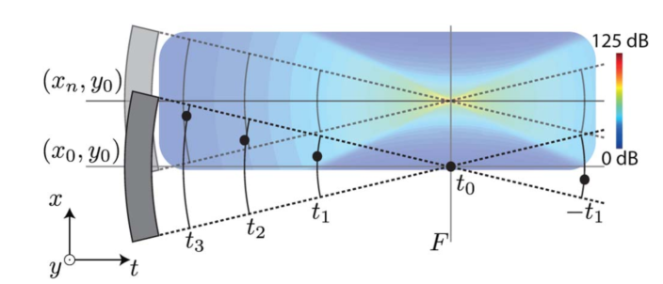
Depth SNR Degradation
Bar Weiss

Slide 2
Agenda
Angled lines results with bigger NA
Y Scan and X Scan Algorithms
X Scan SAFT results

Slide 3
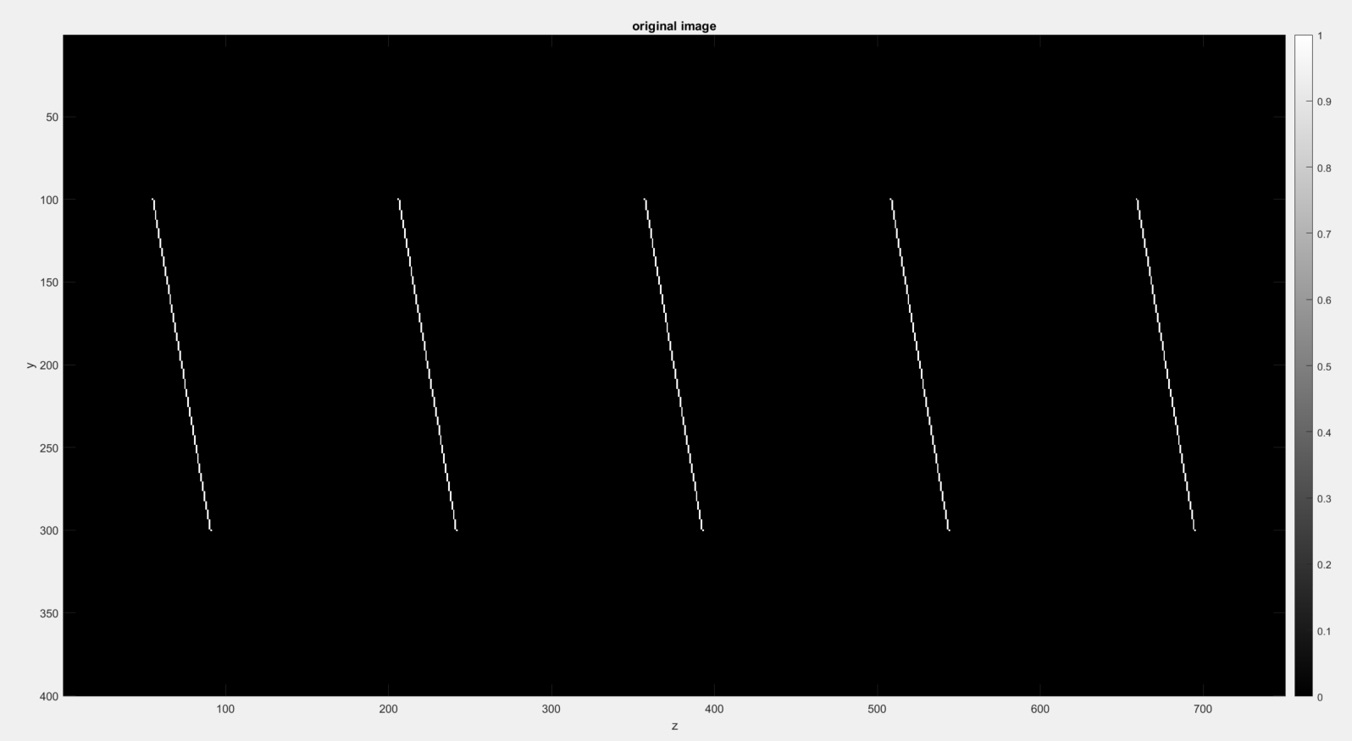
10 degrees Angled Line

Slide 4
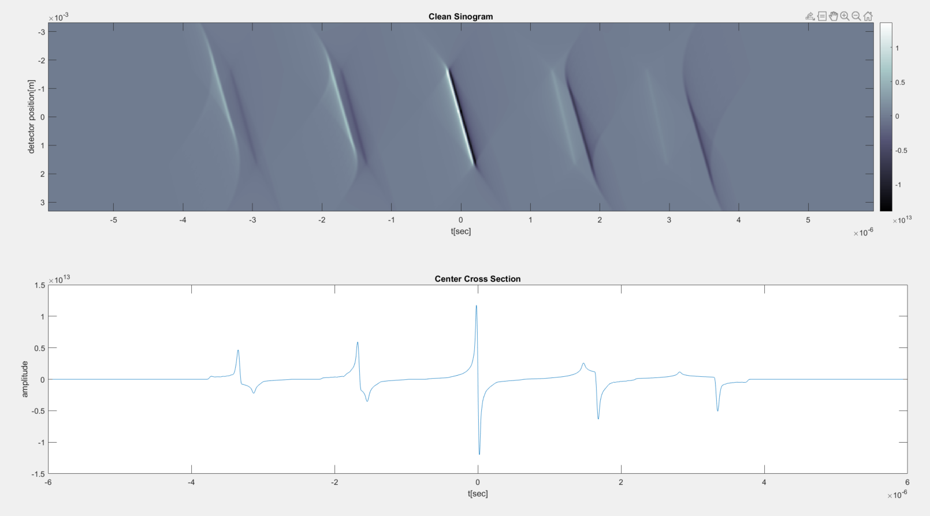
10 degrees Angled Line – Clean Sinogram

Slide 5
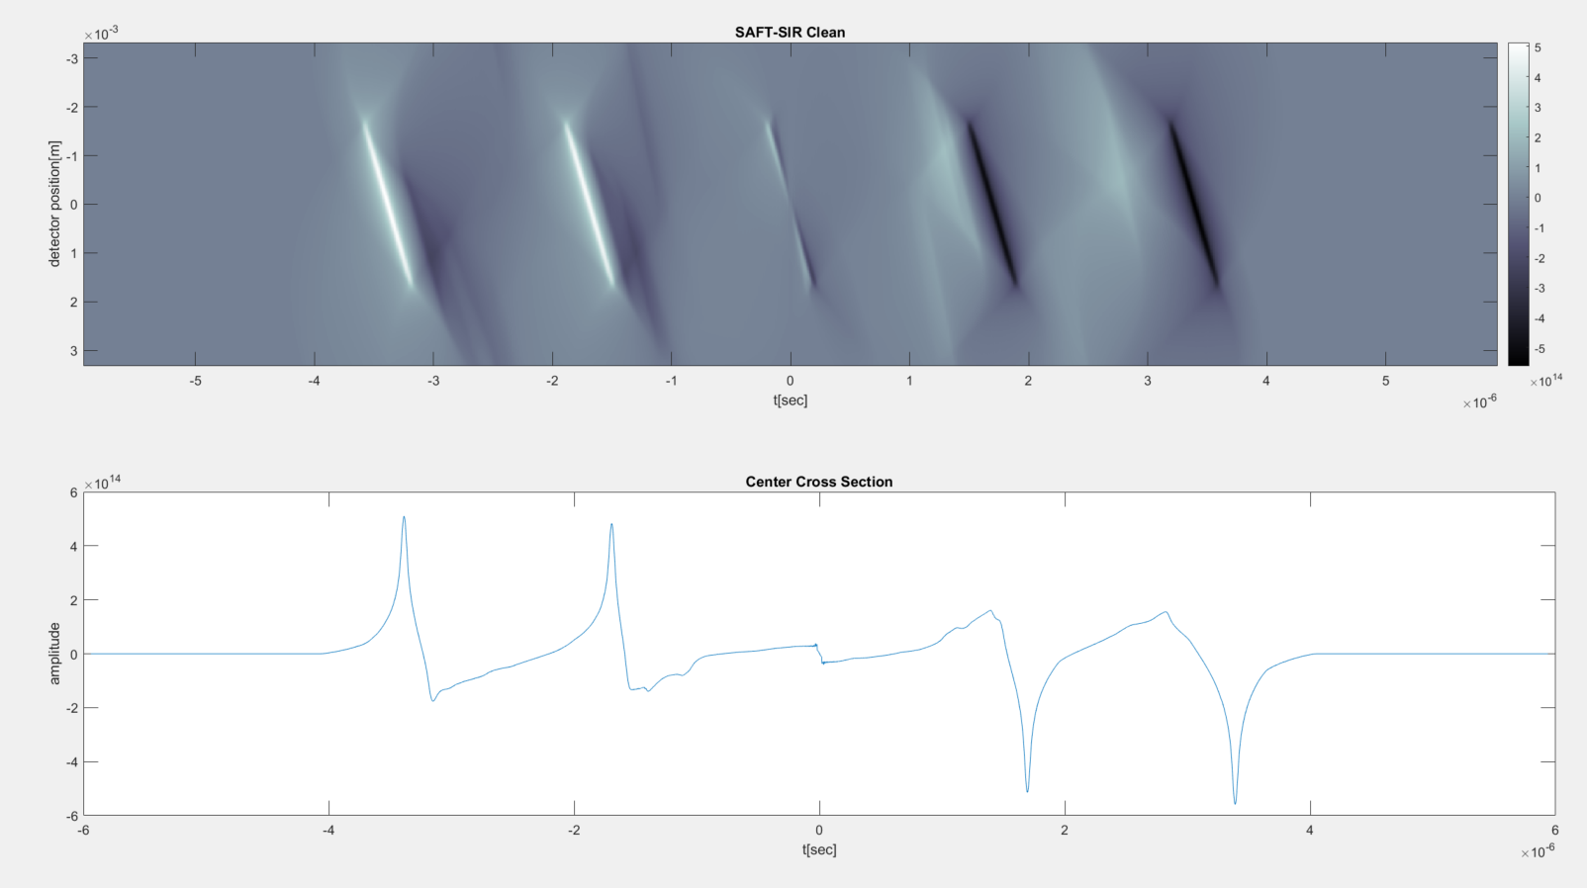
10 degrees Angled Line – Clean SAFT-SIR

Slide 6
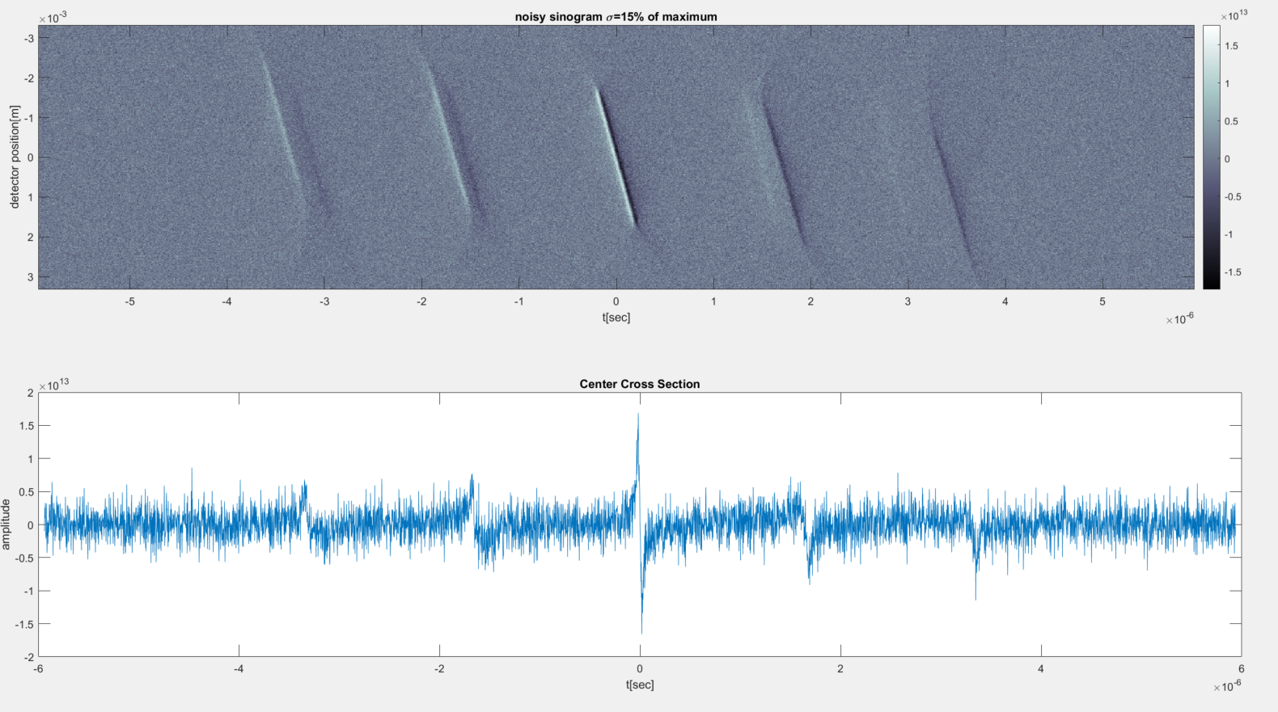
10 degrees Angled Line – Noisy Sinogram

Slide 7
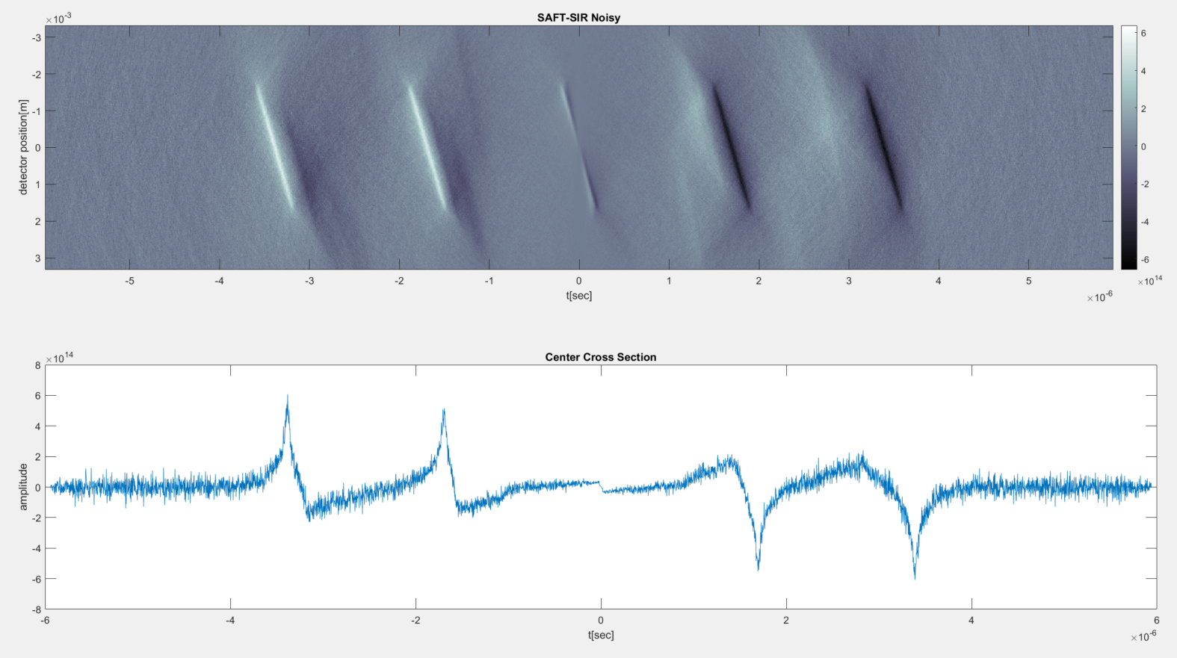
10 degrees Angled Line – Noisy SAFT-SIR

Slide 8
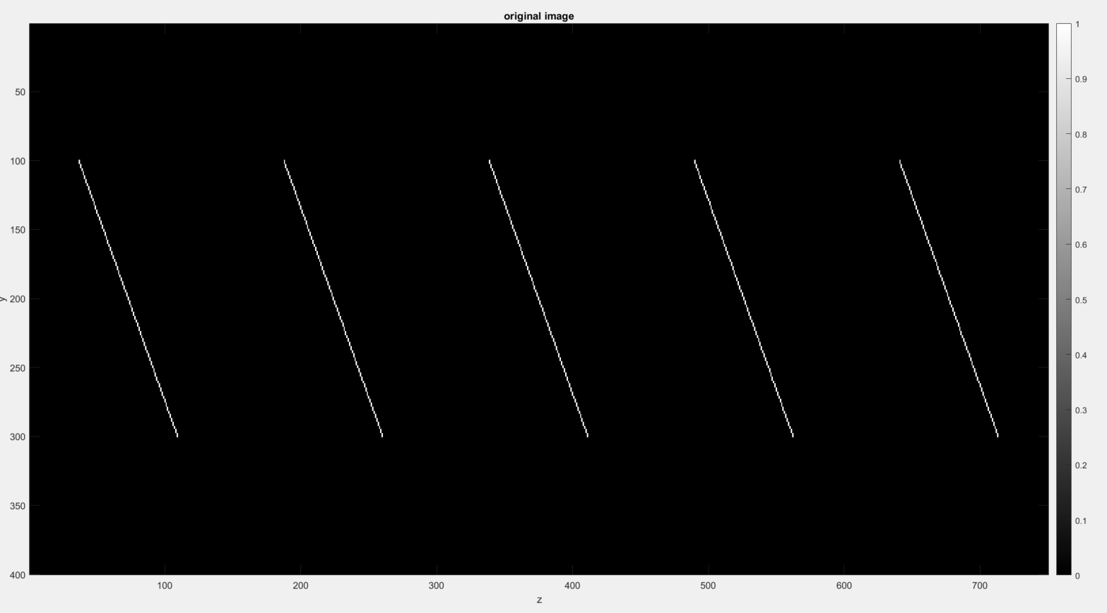
20 degrees Angled Line

Slide 9
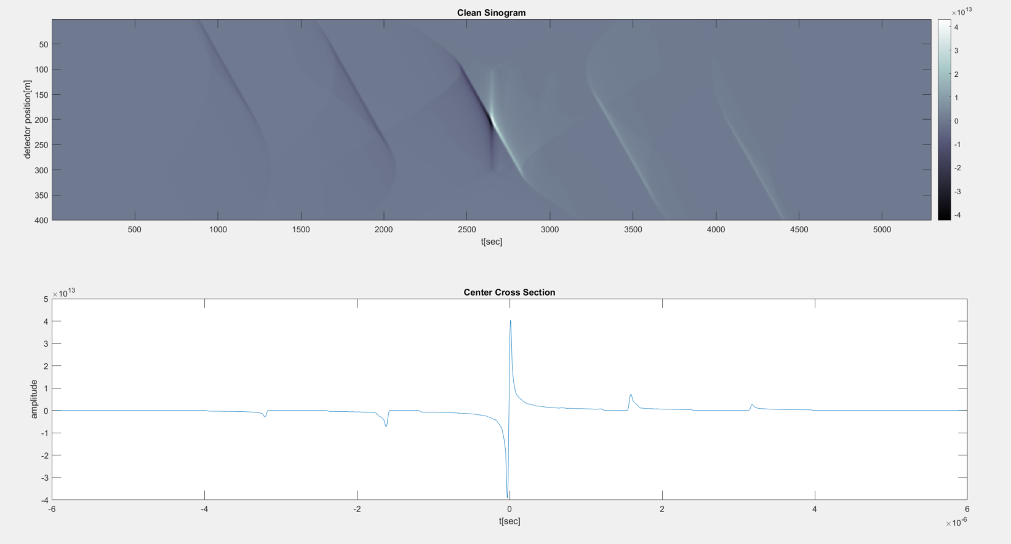
20 degrees Angled Line – Clean Sinogram

Slide 10
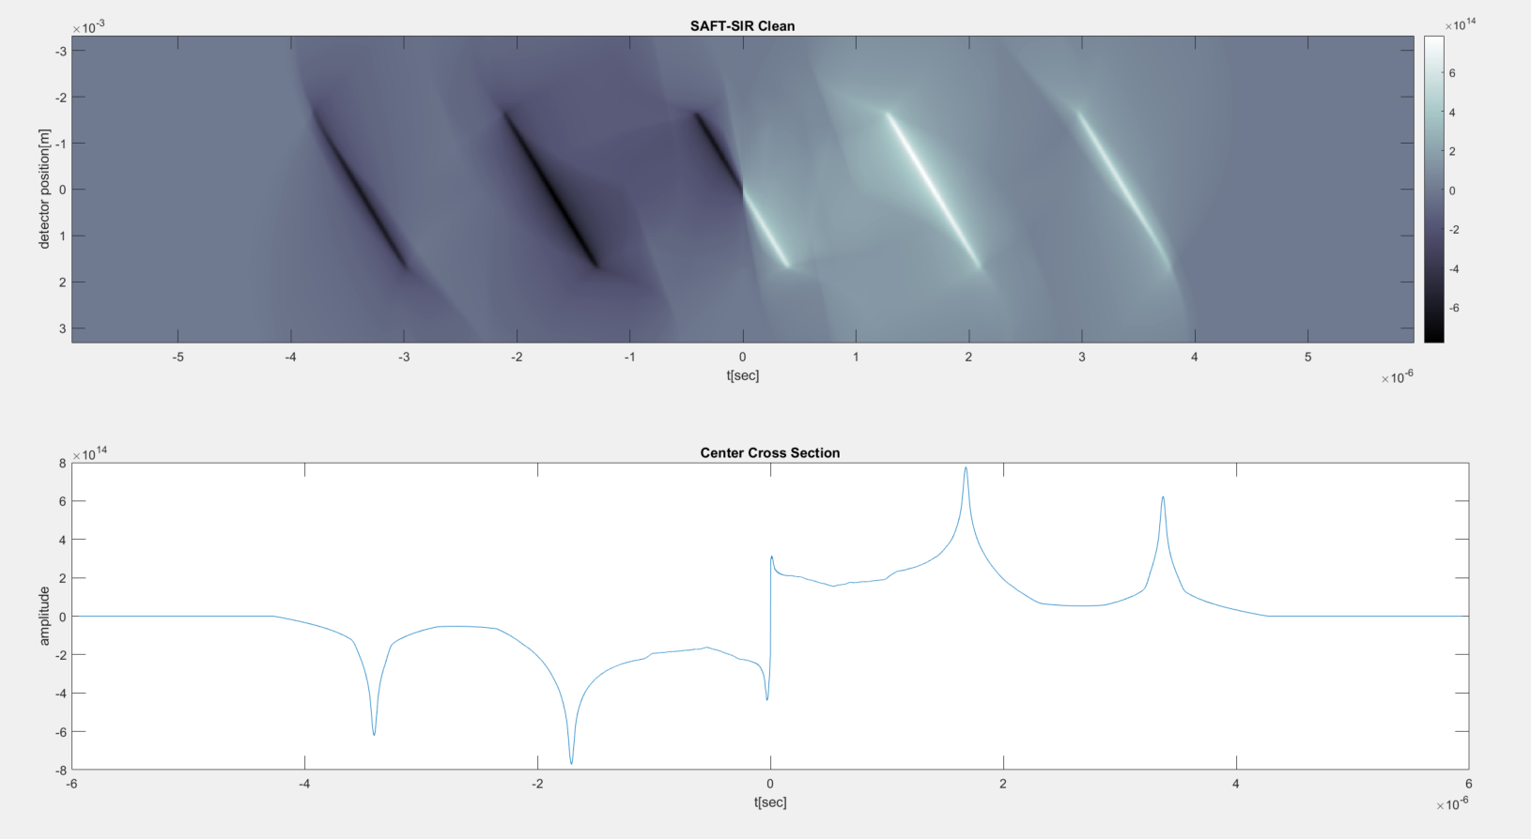
20 degrees Angled Line – Clean SAFT-SIR

Slide 11
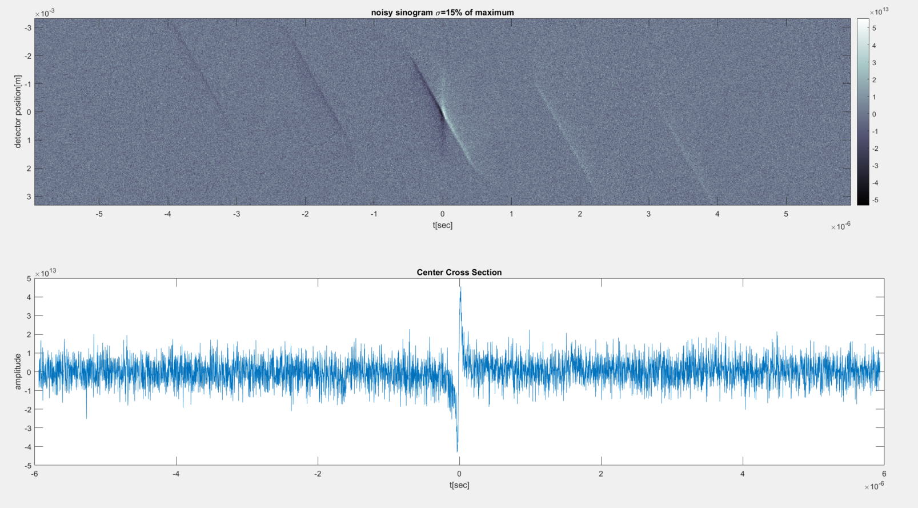
20 degrees Angled Line – Noisy Sinogram

Slide 12
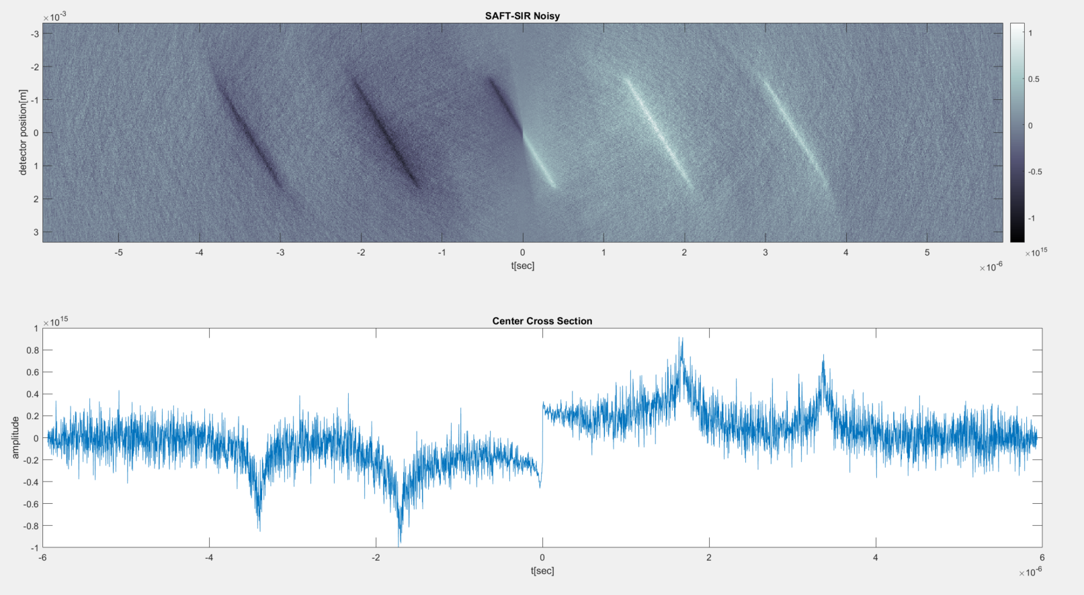
20 degrees Angled Line – Noisy SAFT-SIR

Slide 13
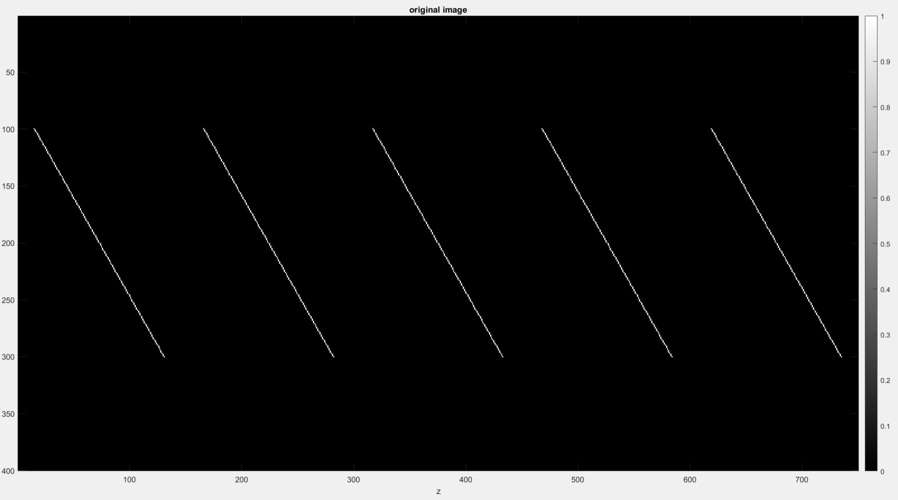
30 degrees Angled Line

Slide 14
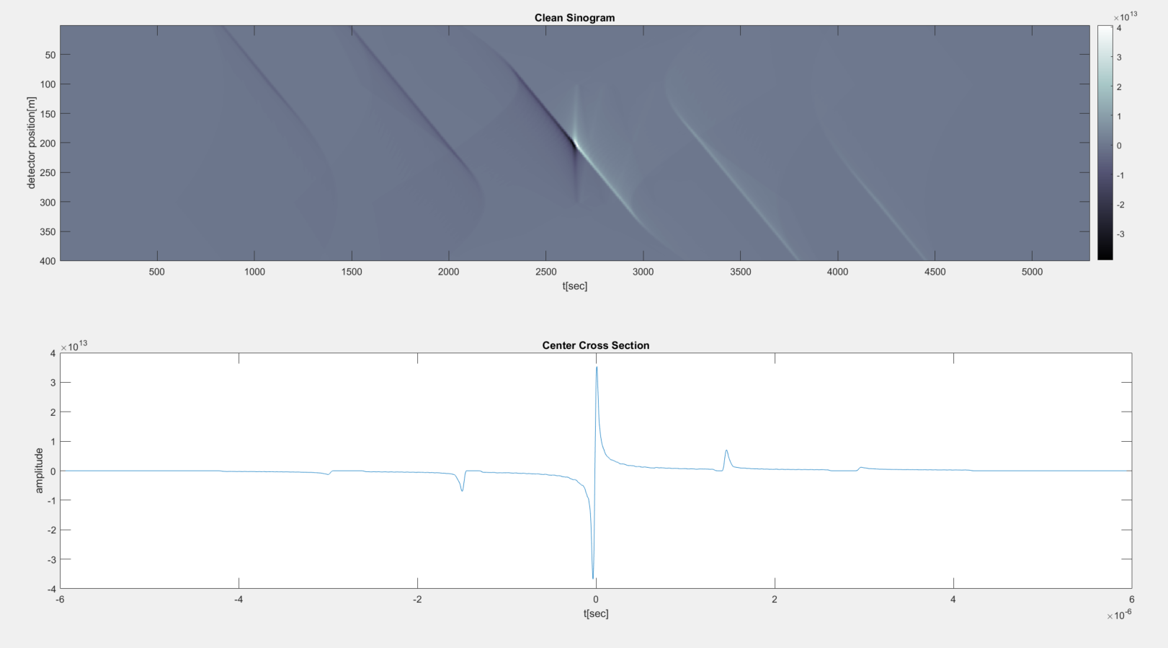
30 degrees Angled Line – Clean Sinogram

Slide 15
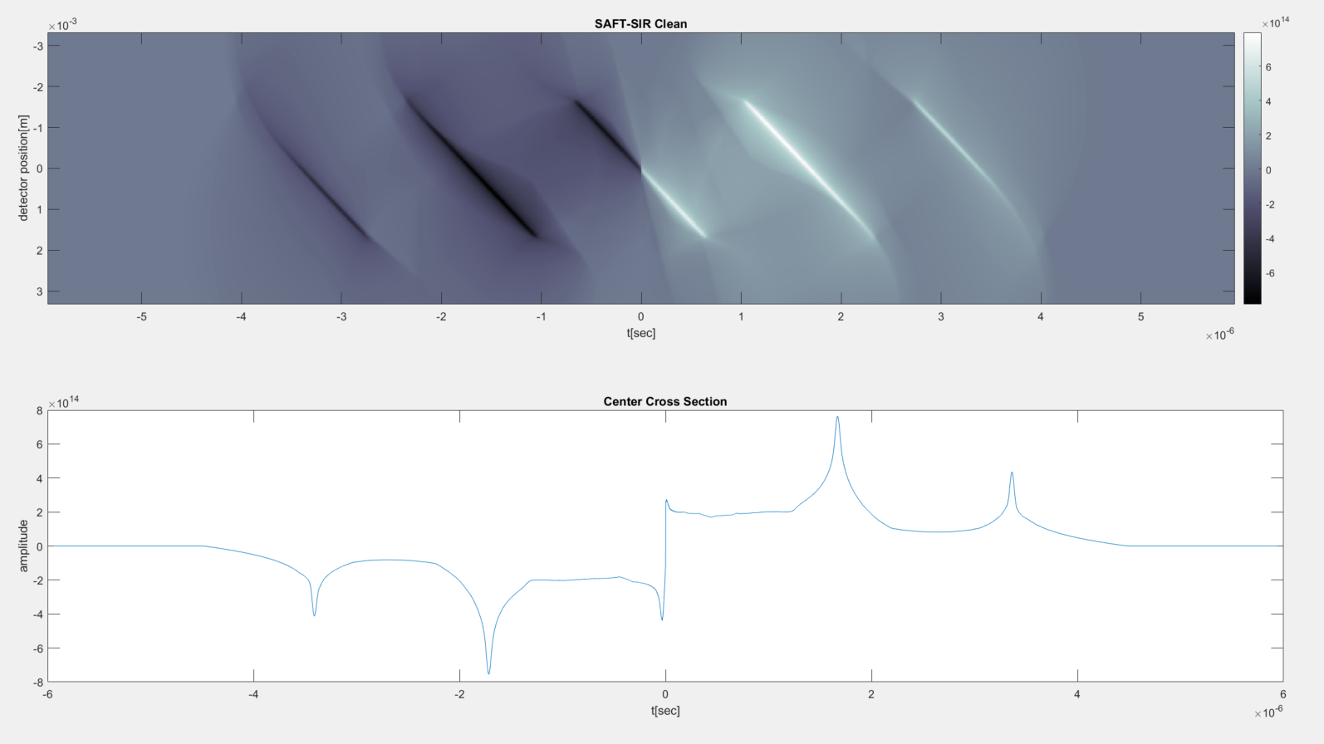
30 degrees Angled Line – Clean SAFT-SIR

Slide 16
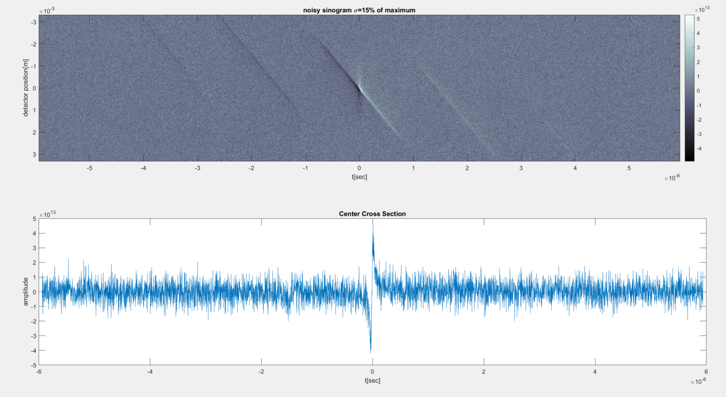
30 degrees Angled Line – Noisy Sinogram

Slide 17

30 degrees Angled Line – Noisy SAFT-SIR

Slide 18
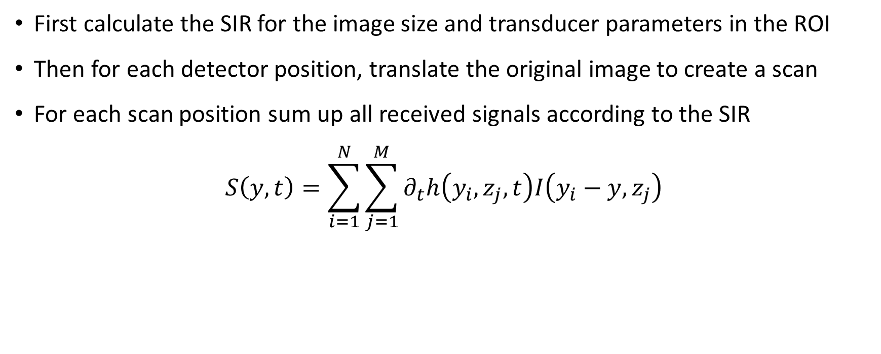
Y Scan Algorithm
First calculate the SIR for the image size and transducer parameters in the ROI
Then for each detector position, translate the original image to create a scan
For each scan position sum up all received signals according to the SIR
$$S\left(y,t\right)=\sum_{i=1}^{N}{\sum_{j=1}^{M}{∂_{t}h\left(y_{i},z_{j},t\right)I\left(y_{i}−y,z_{j}\right)}}$$
Transducer
y-scan

Slide 19
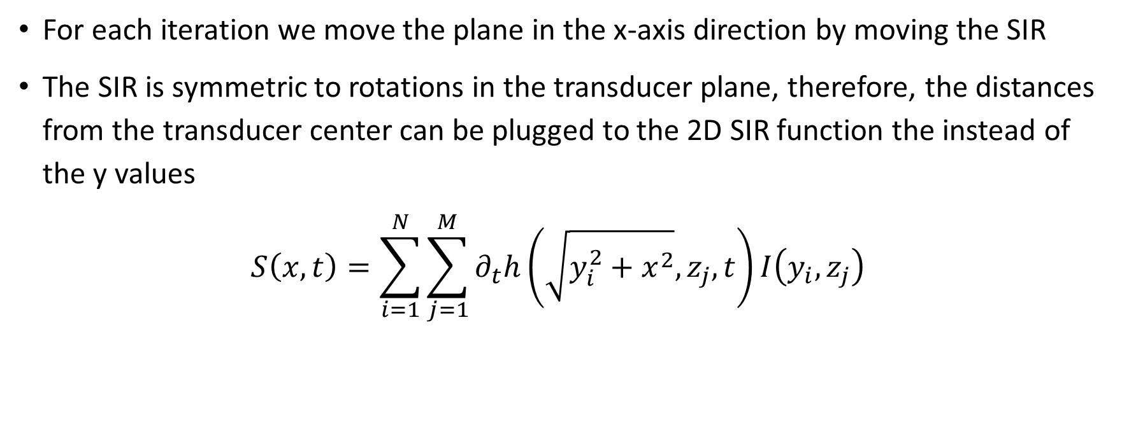
X Scan Algorithm
For each iteration we move the plane in the x-axis direction by moving the SIR
The SIR is symmetric to rotations in the transducer plane, therefore, the distances from the transducer center can be plugged to the 2D SIR function the instead of the y values
$$S\left(x,t\right)=\sum_{i=1}^{N}{\sum_{j=1}^{M}{∂_{t}h\left(\sqrt{y_{i}^{2}+x^{2}},z_{j},t\right)I\left(y_{i},z_{j}\right)}}$$
Transducer
x-scan

Slide 20
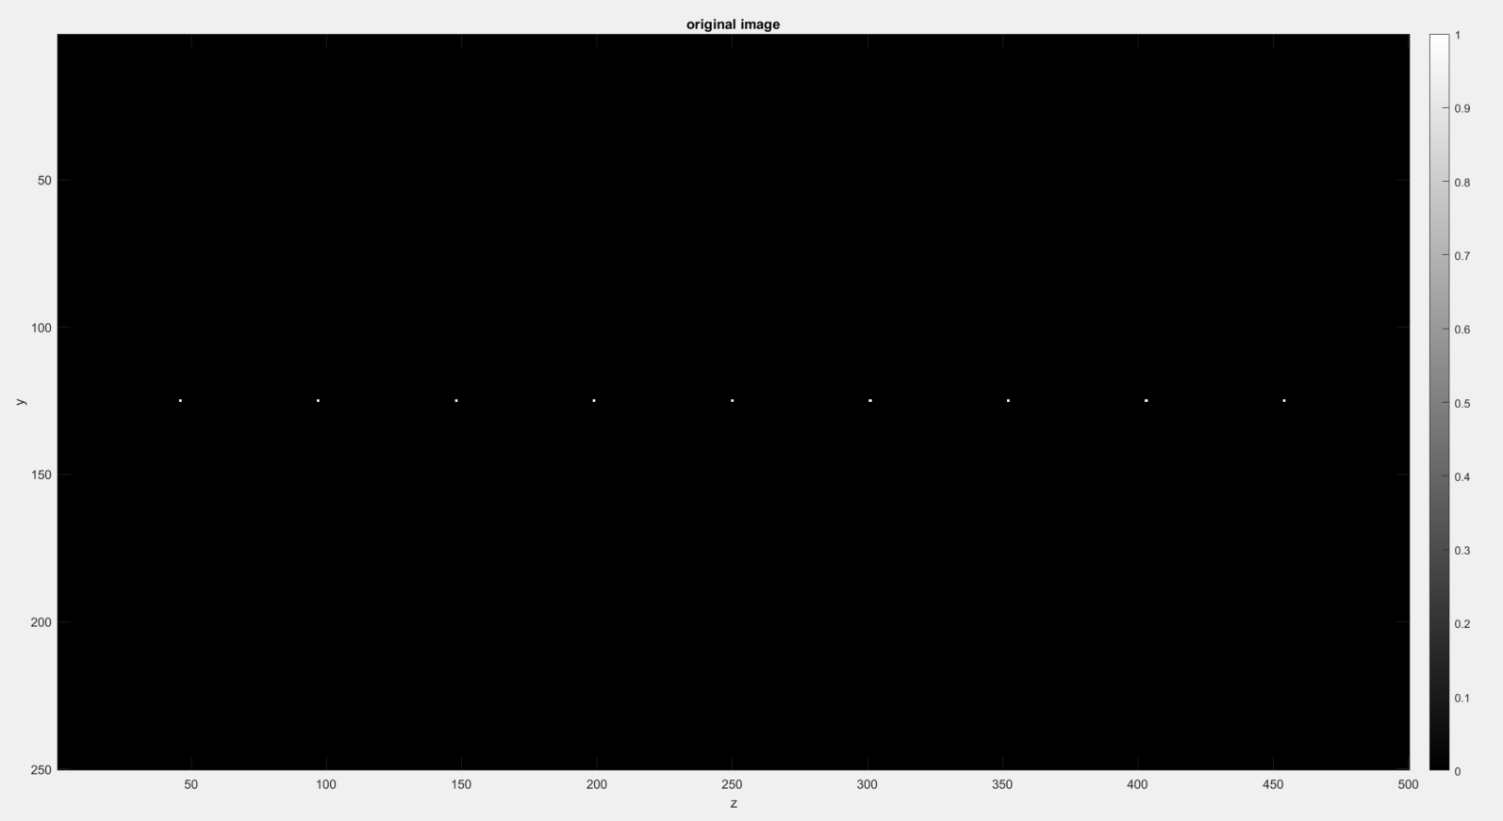
X Scan Results – Points

Slide 21
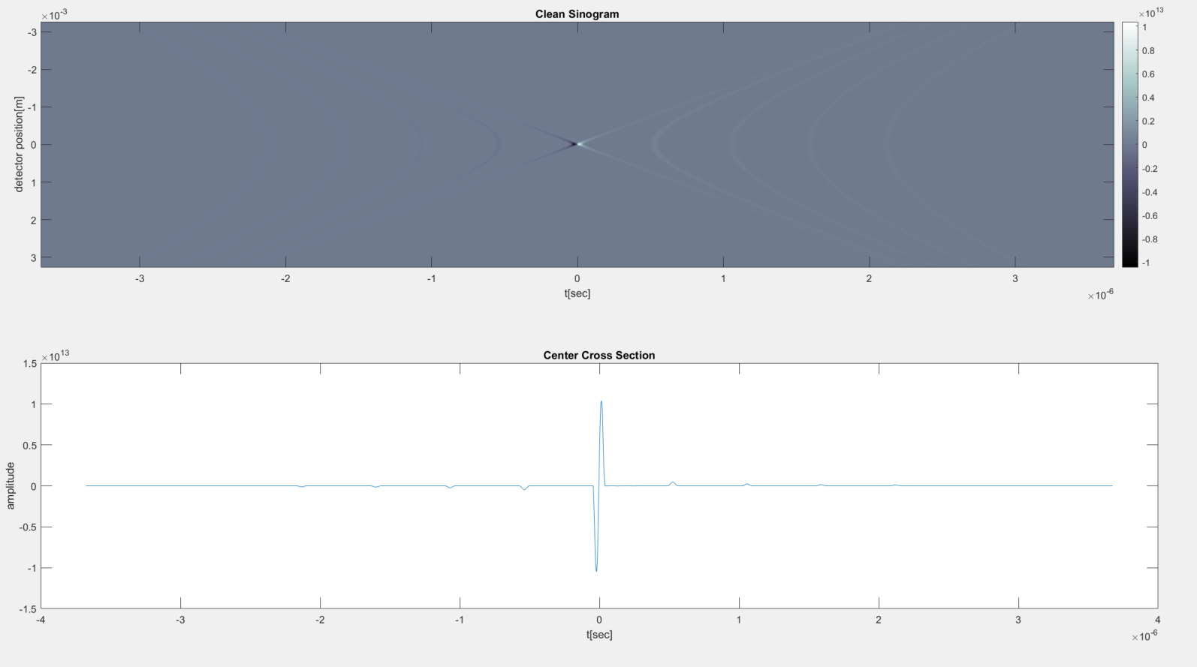
Sinogram Points - Clean

Slide 22
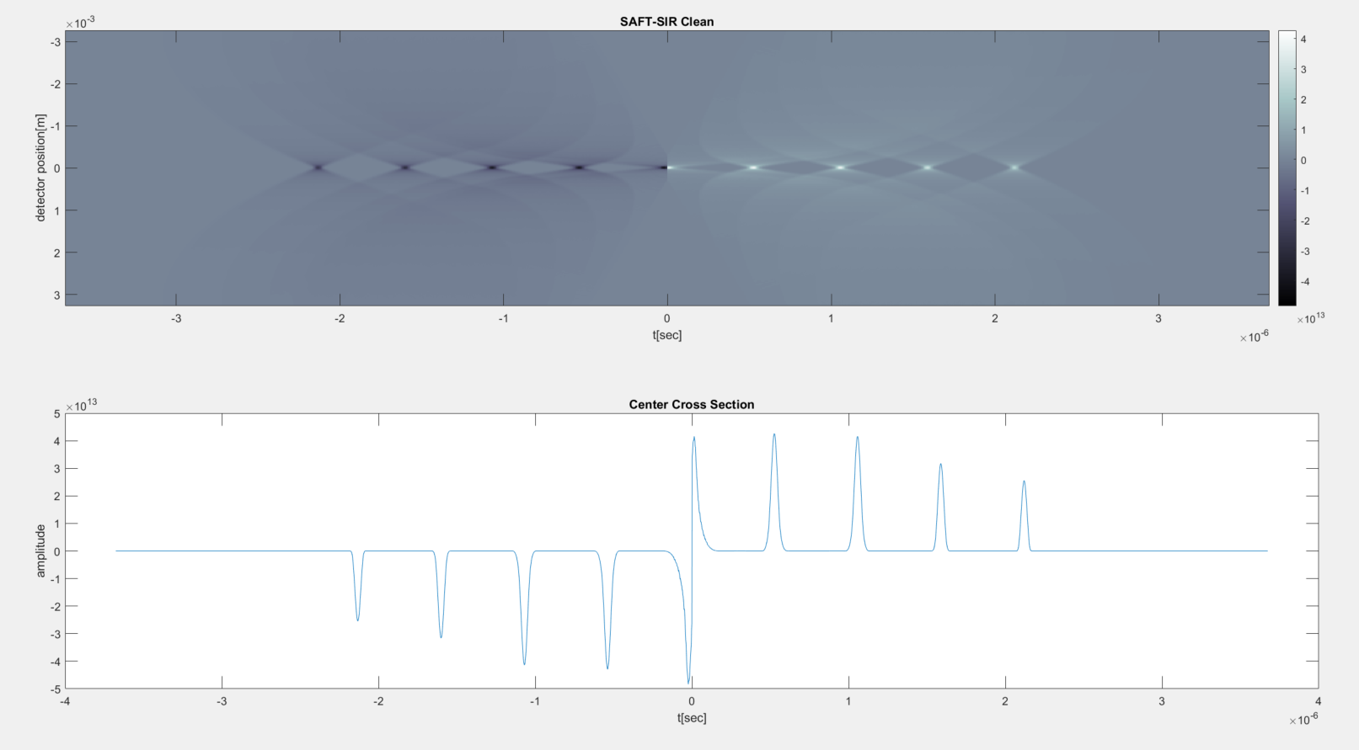
SAFT-SIR Points - Clean

Slide 23
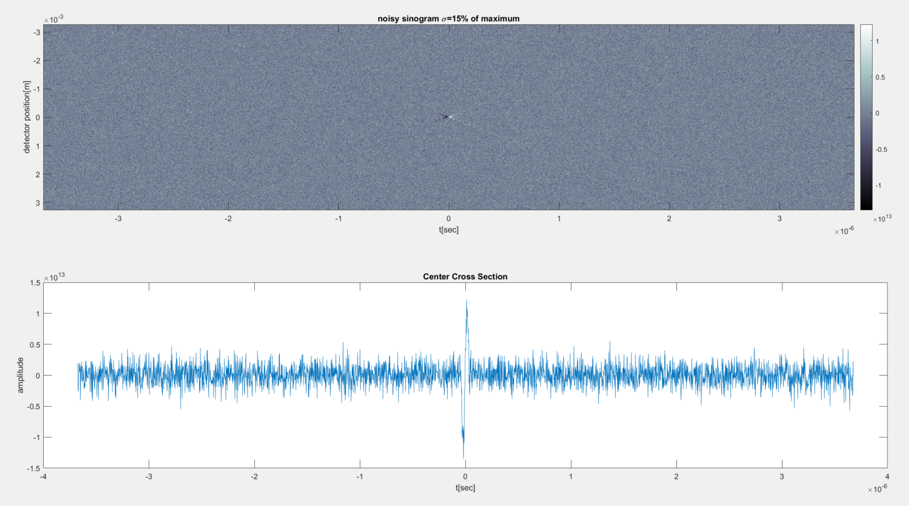
Sinogram 20 Degrees - Noisy

Slide 24
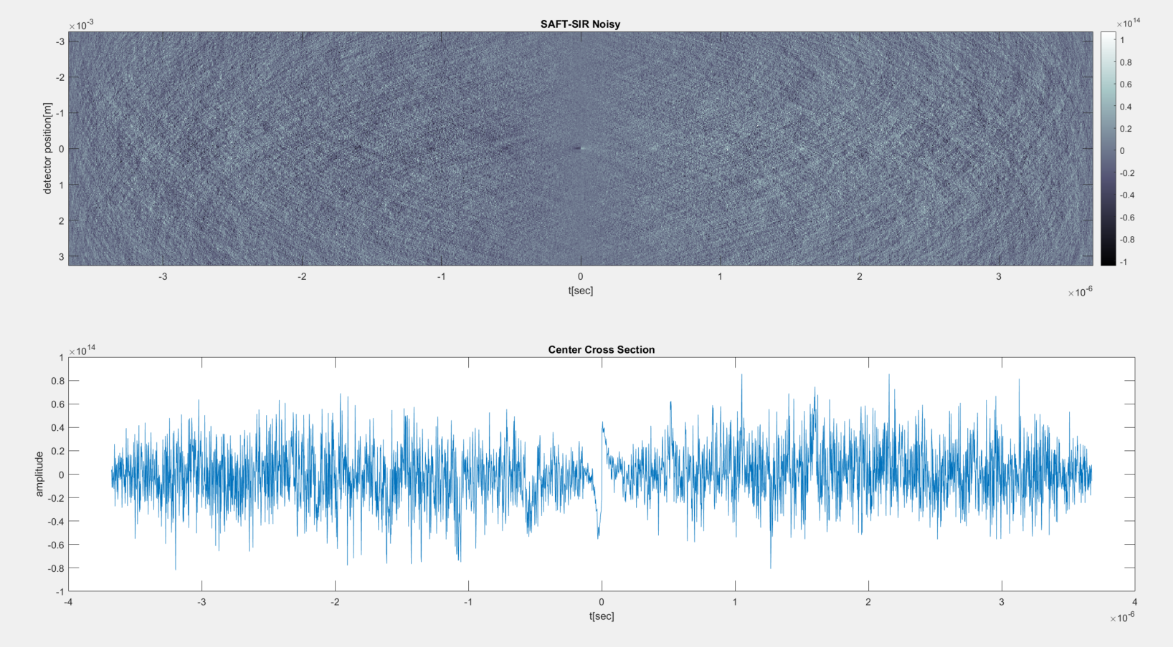
SAFT-SIR 20 Degrees - Noisy

Slide 25
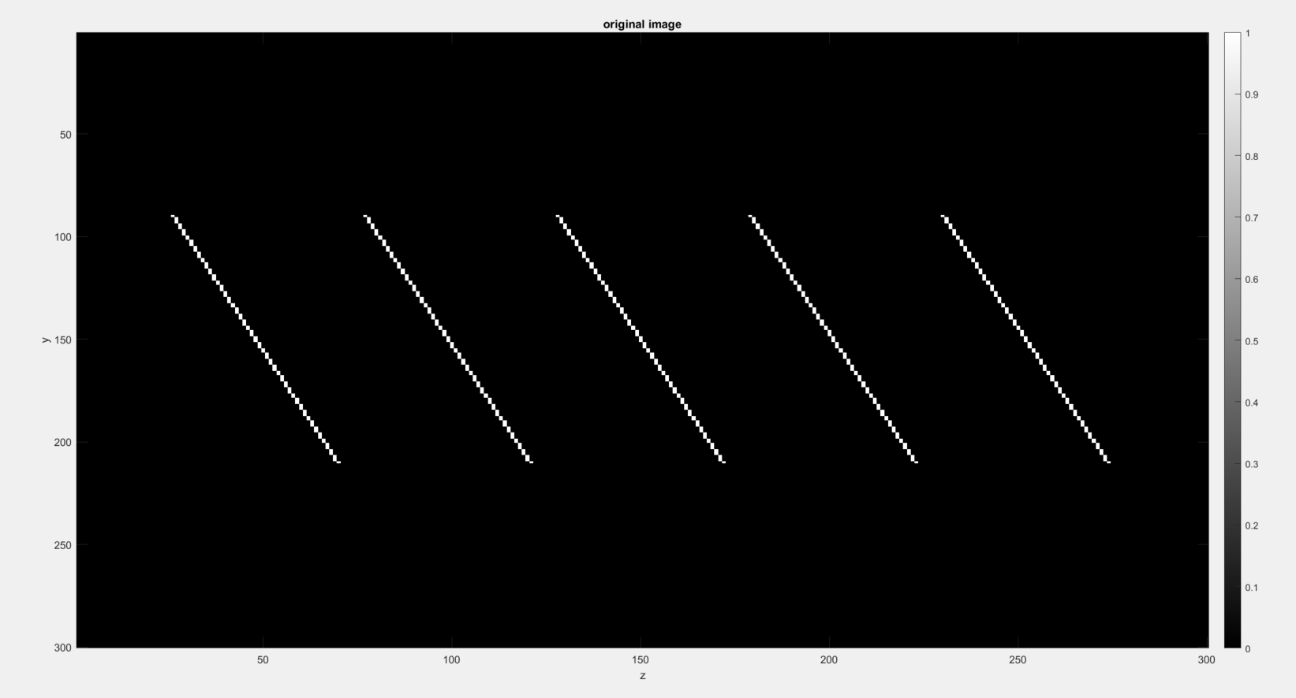
X Scan Results – Angled line 20 Degrees

Slide 26
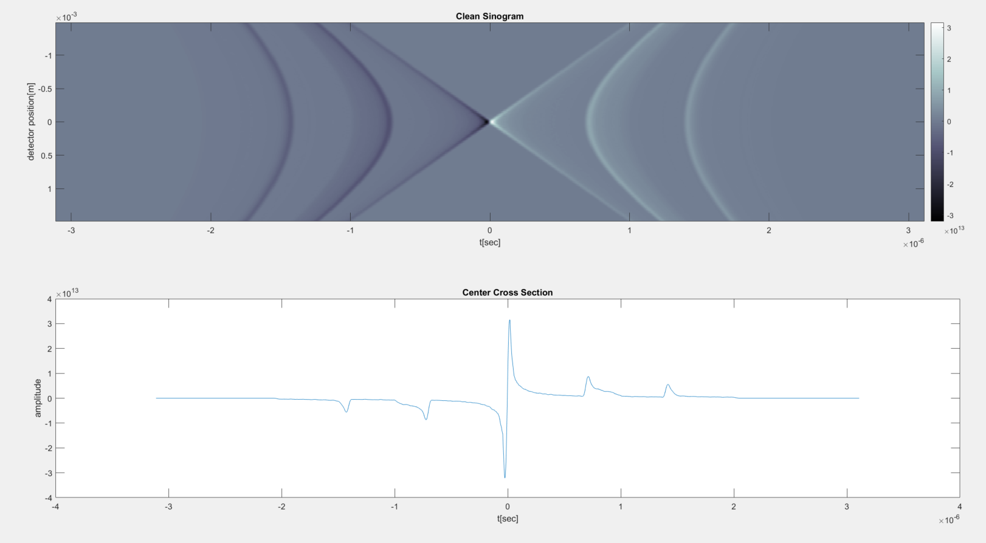
Sinogram 20 Degrees - Clean

Slide 27
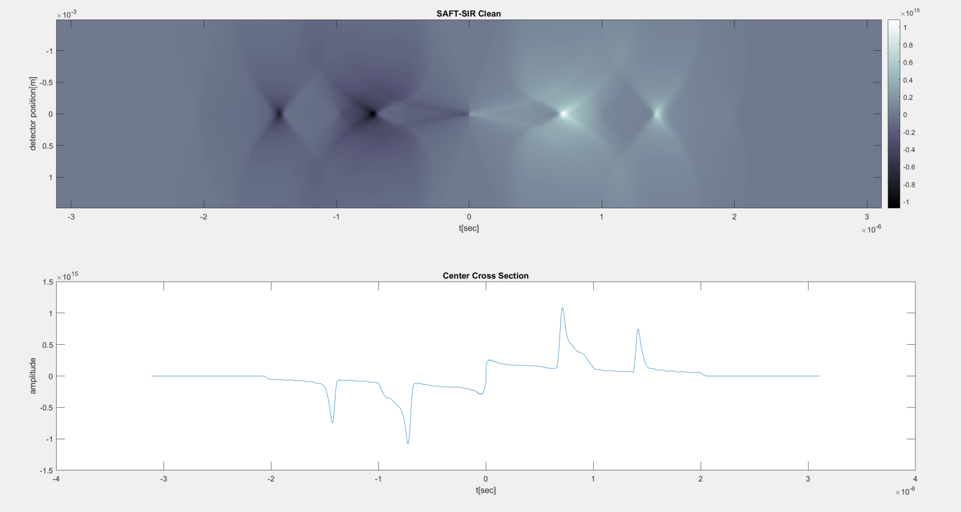
SAFT-SIR 20 Degrees - Clean

Slide 28
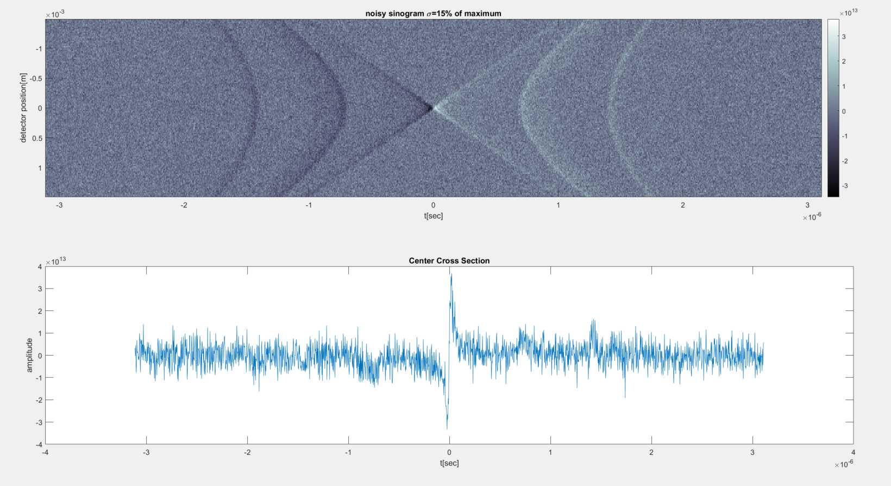
Sinogram 20 Degrees - Noisy

Slide 29
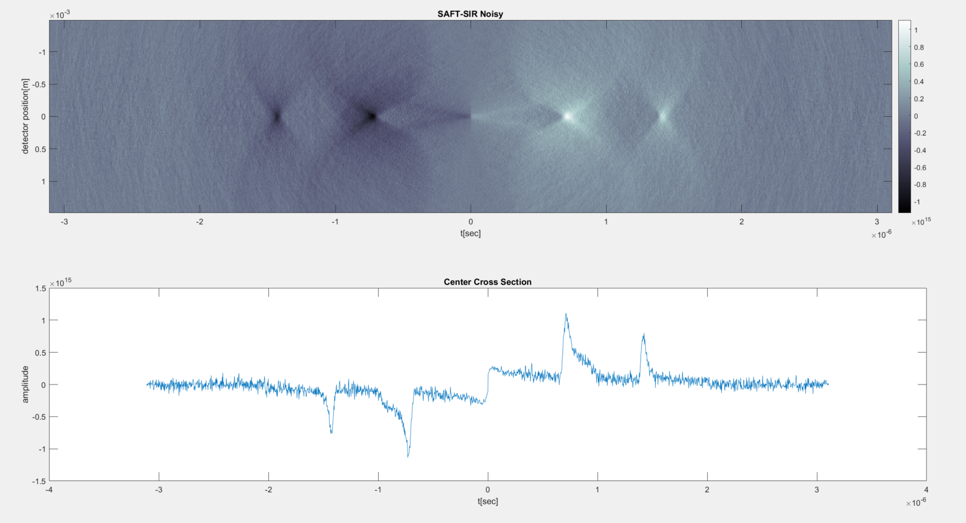
SAFT-SIR 20 Degrees - Noisy

Slide 30
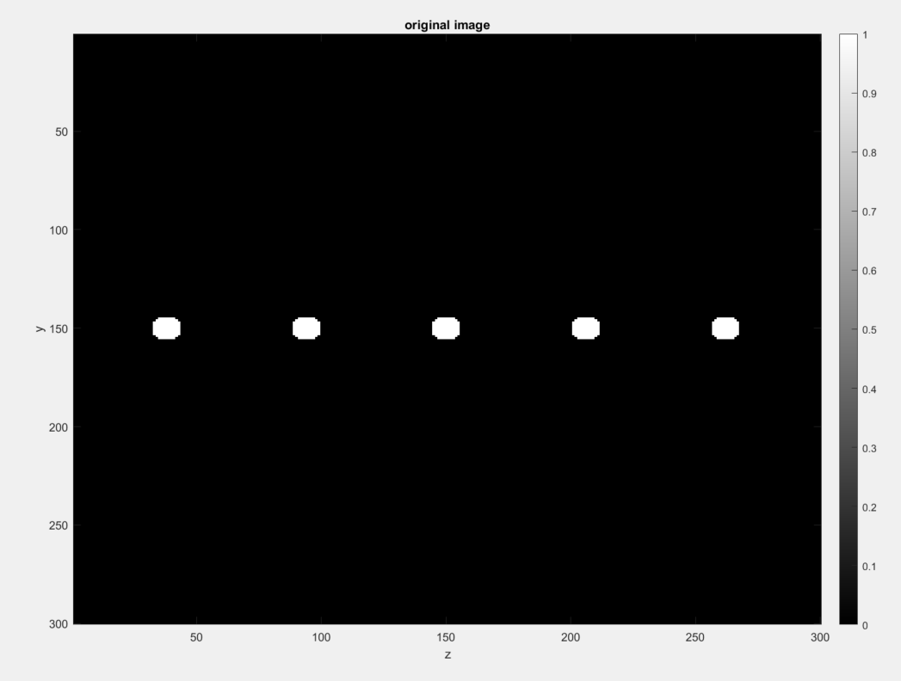
X Scan Results – Circles

Slide 31
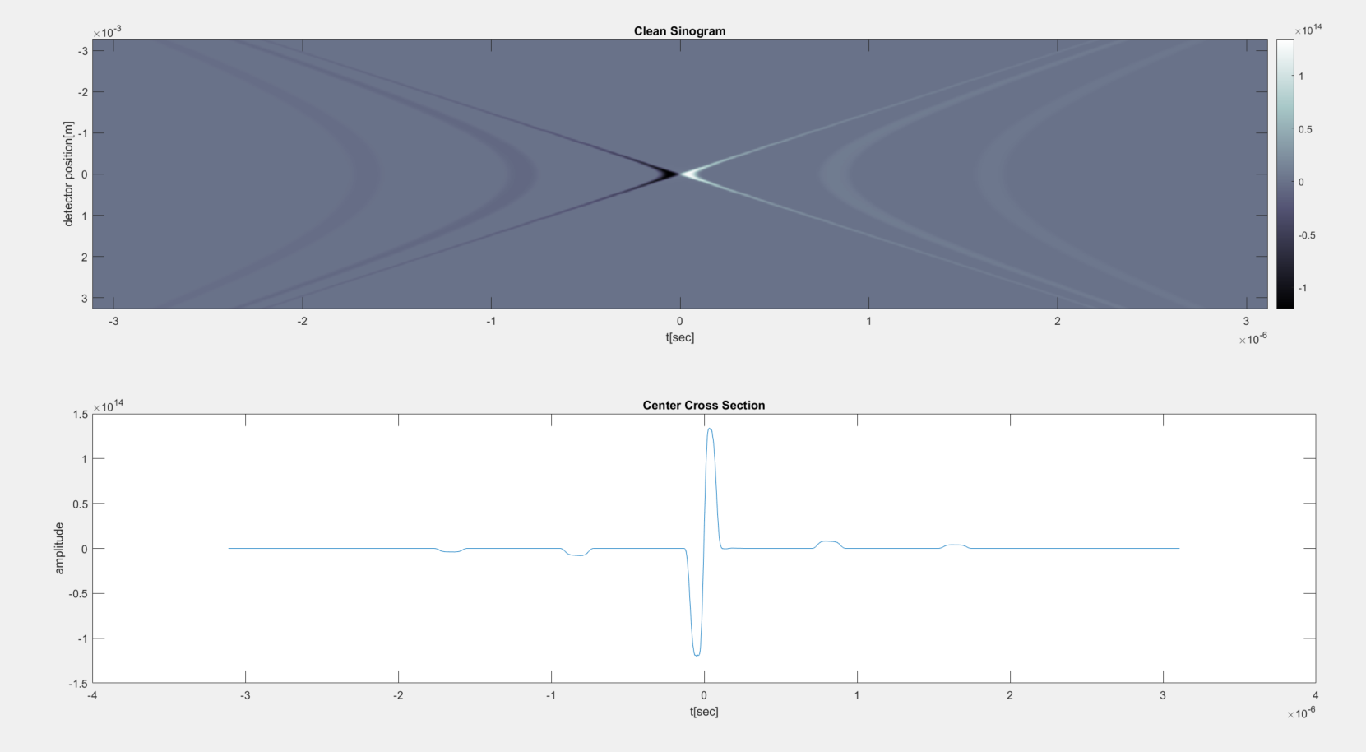
Sinogram Circles - Clean

Slide 32
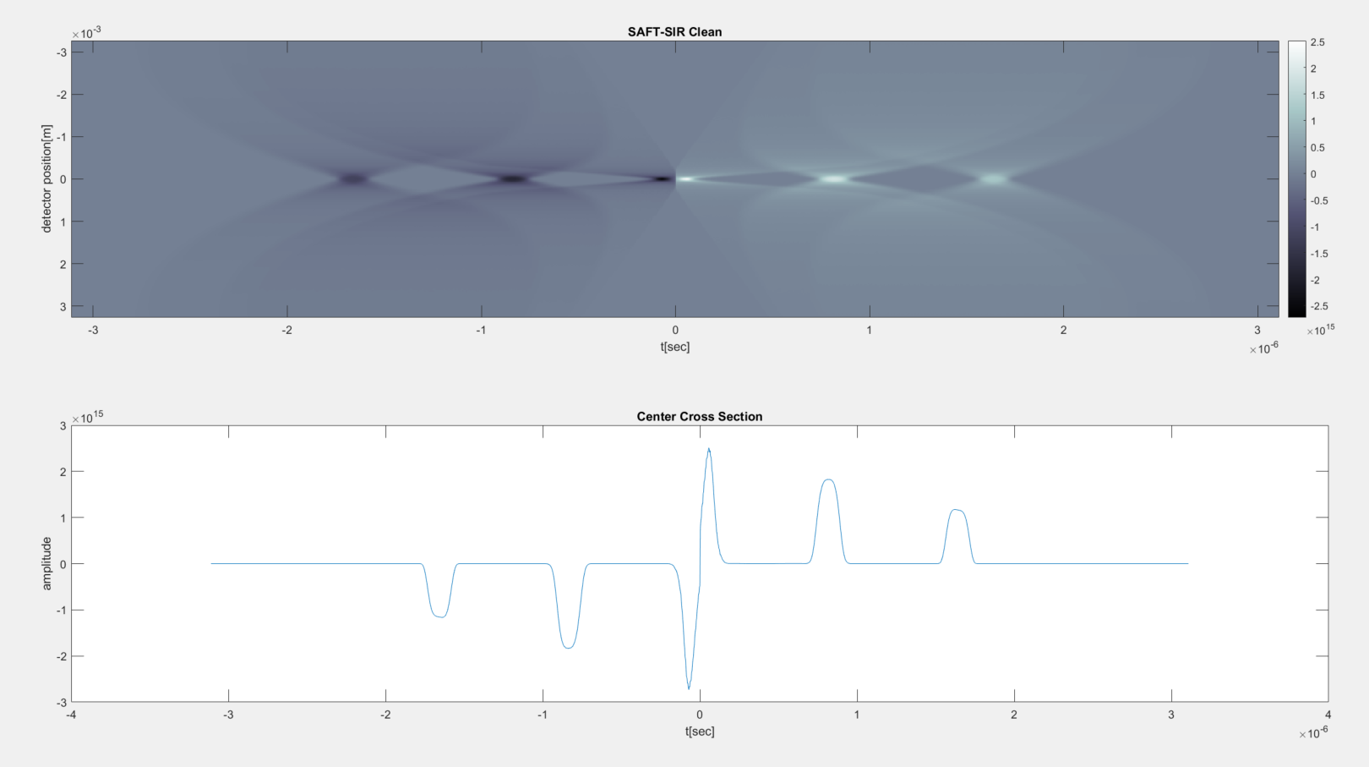
SAFT-SIR 20 Degrees - Clean

Slide 33
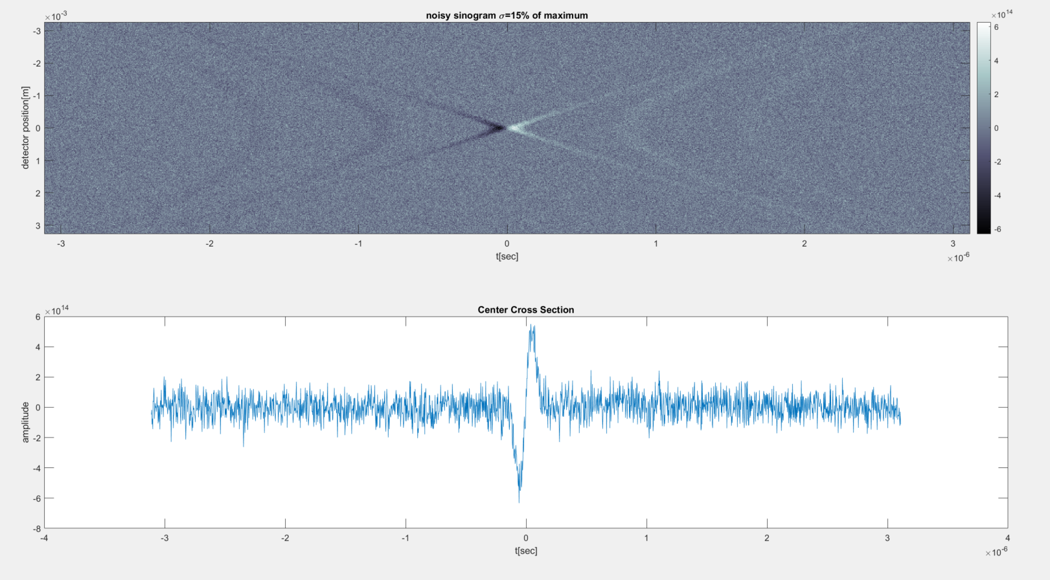
Sinogram 20 Degrees - Noisy

Slide 34
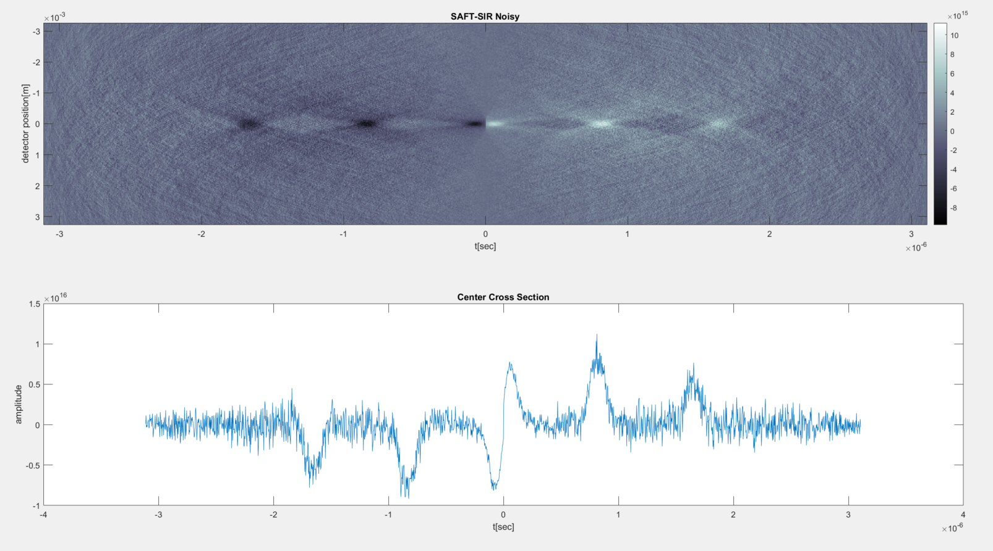
SAFT-SIR 20 Degrees - Noisy

Slide 35
Backup

Slide 36
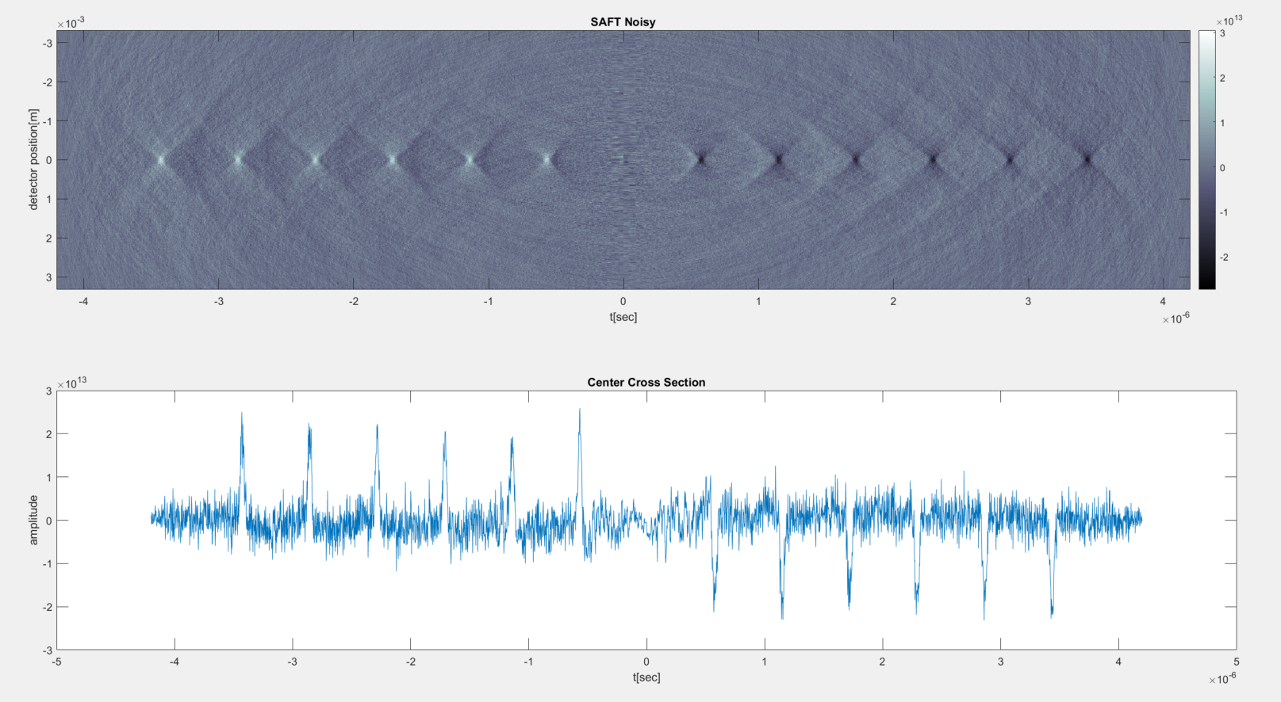
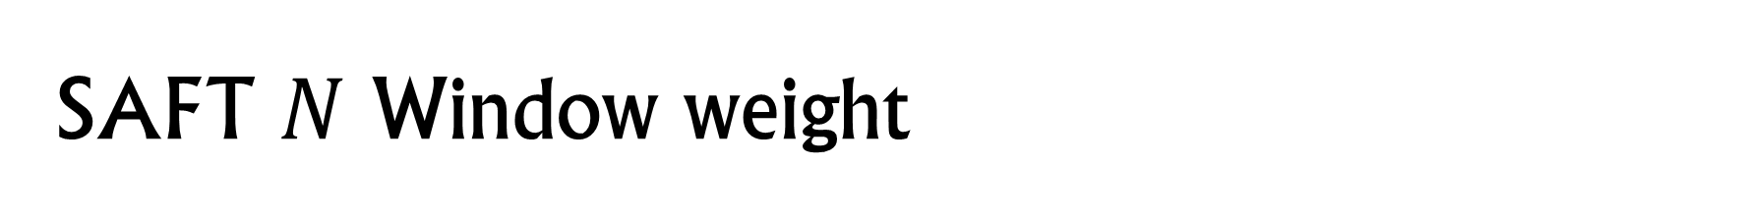
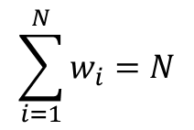
SAFT $N$ Window weight
$$\sum_{i=1}^{N}{w_{i}}=N$$

Slide 37
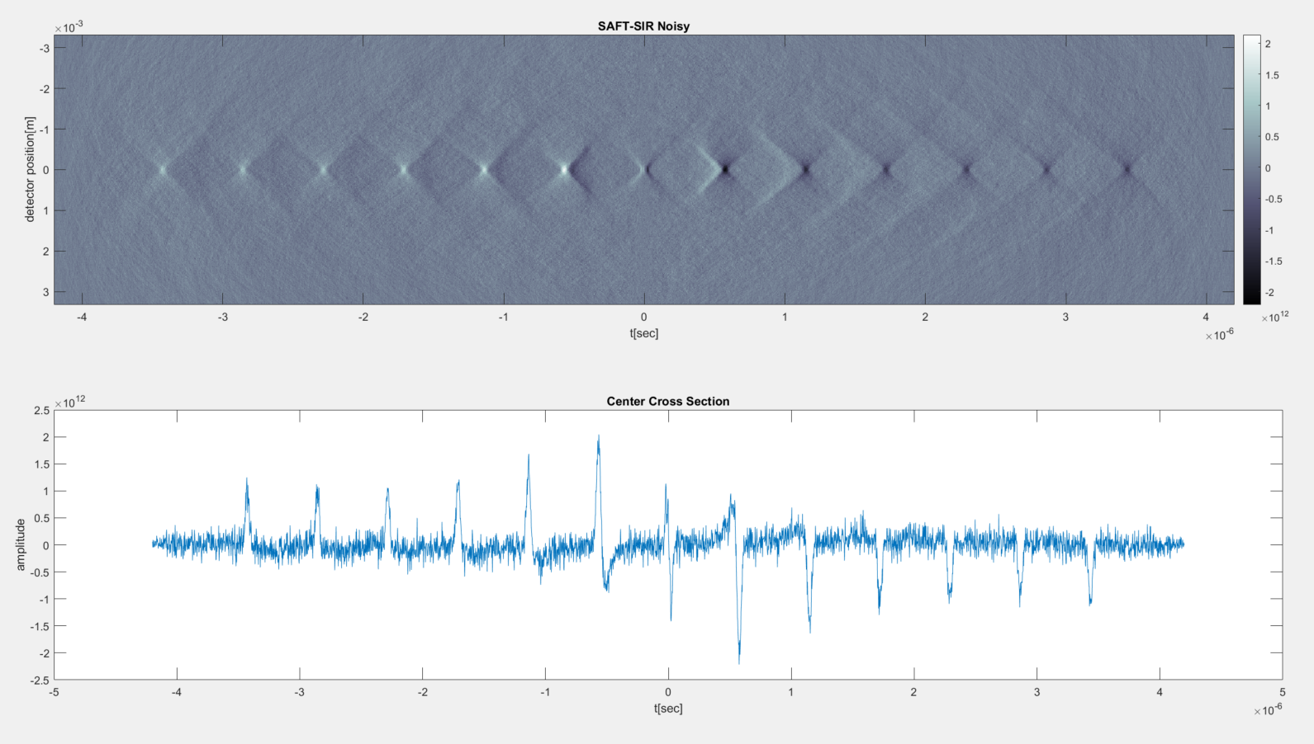
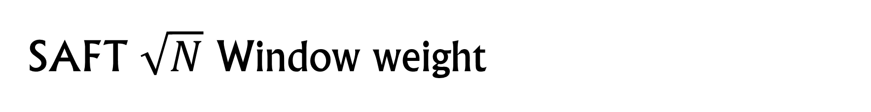
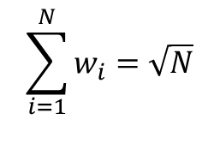
SAFT $\sqrt{N}$ Window weight
$$\sum_{i=1}^{N}{w_{i}}=\sqrt{N}$$

Slide 38
Y Scan Diagram
Transducer
y-scan

Slide 39
References
Rongkang Gao, Qiang Xue, Yaguang Ren, Hai Zhang, Liang Song, Chengbo Liu, “Achieving depth-independent lateral resolution in AR-PAM using the synthetic-aperture focusing technique”, Photoacoustics, Volume 26, 2022
Jake Turner, Héctor Estrada, Moritz Kneipp and Daniel Razansky “Improved optoacoustic microscopy through three-dimensional spatial impulse response synthetic aperture focusing technique”, Optics Letters, 2014
Joging Park, Seungwan Jeon, Jing Meng, Liang Song, Jin S. Lee and Chulhong Kim, “delay-muliply-and-sum-based synthetic aperture focusing technique in photoacoustic microscopy”, Journal of Biomedical Optics, 2016

